Slide 1
Indoor Environment Mapping Tutorials
Using RTAB-Map for mapping with Kinect

Slide 2
Required ROS Packages
For interfacing Kinect with ROS
libfreenect - sudo apt-get install libfreenect-dev
freenect_launch - sudo apt-get install ros-indigo-freenect-launch
For RTAB-Map with ROS
rtabmap_ros - sudo apt-get install ros-indigo-rtabmap-ros

Slide 3
RTAB-Map
Simultaneous Localisation And Mapping (SLAM) is the computational problem of constructing or updating a map of an unknown environment while simultaneously keeping track of an agent's location within it
RTAB-Map (Real-Time Appearance-Based Mapping) is a RGB-D Graph-Based SLAM approach based on an incremental appearance-based loop closure detector
RTAB-Map can be used alone with a hand-held Kinect or stereo camera for 6DoF RGB-D mapping

Slide 4
Procedure
Connect Kinect camera to PC/Laptop
Run “roslaunch freenect_launch freenect.launch depth_registration:=true”. This will start the connection between the Kinect camera and ROS. The point cloud, depth image and RGB image of the Kinect camera will be available as ROS topics
Point cloud - /camera/depth_registered/points
Depth image - /camera/depth_registered/image_raw
Color image - /camera/rgb/image_rect_color

Slide 5
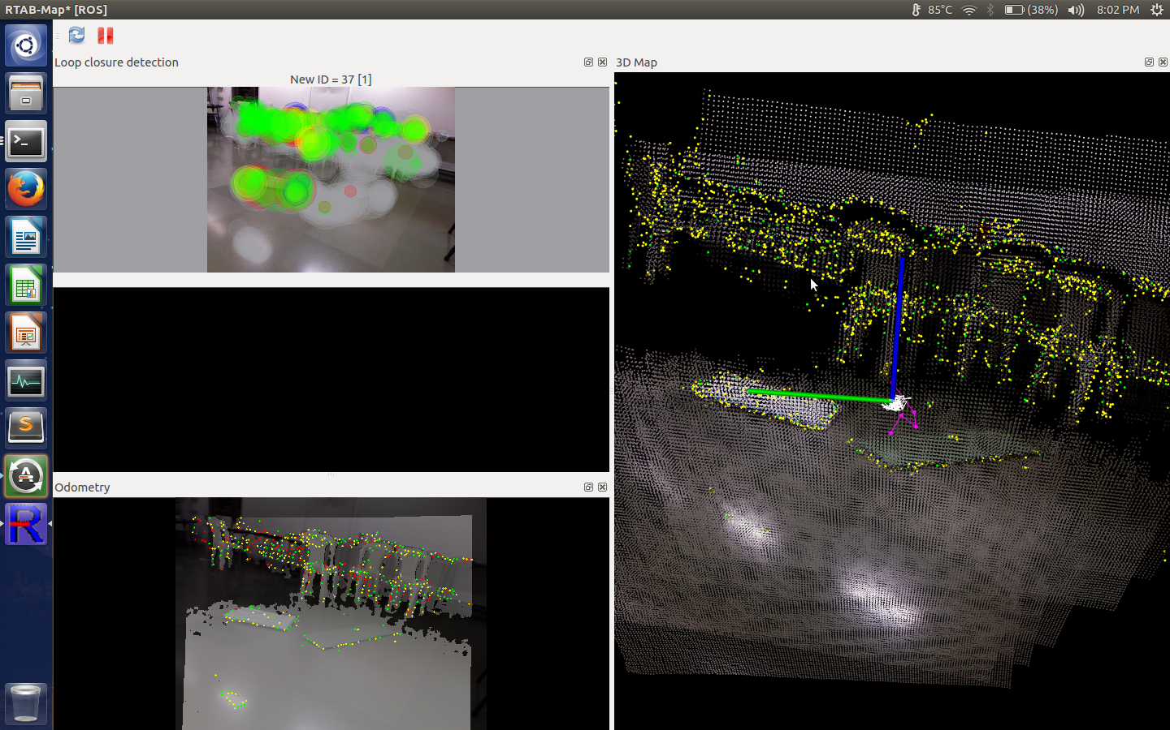
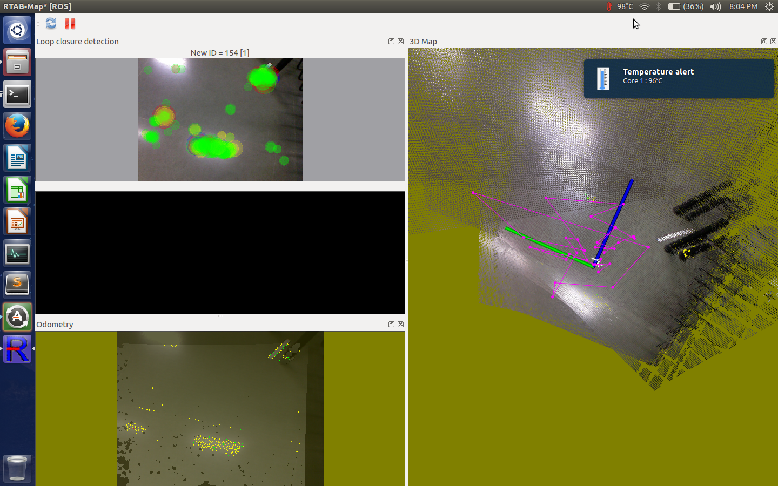
Procedure
Run “roslaunch rtabmap_ros rgbd_mapping.launch”. This will start RTAB-Map.
Move the Kinect camera slowly to map. The 3D map window changes colour based on how fast the camera is being moved:
Black - The camera is being moved sufficiently slow
Yellow - Warning. The camera is being moved fast. RTAB-Map might lose track of the camera’s location

Slide 6
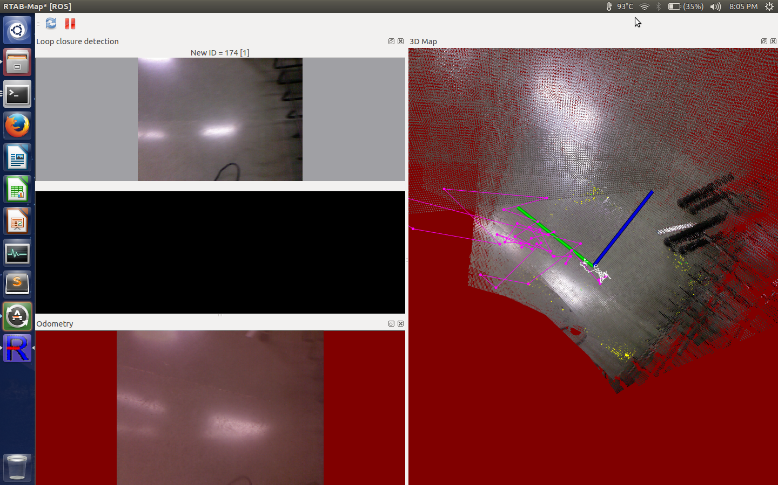
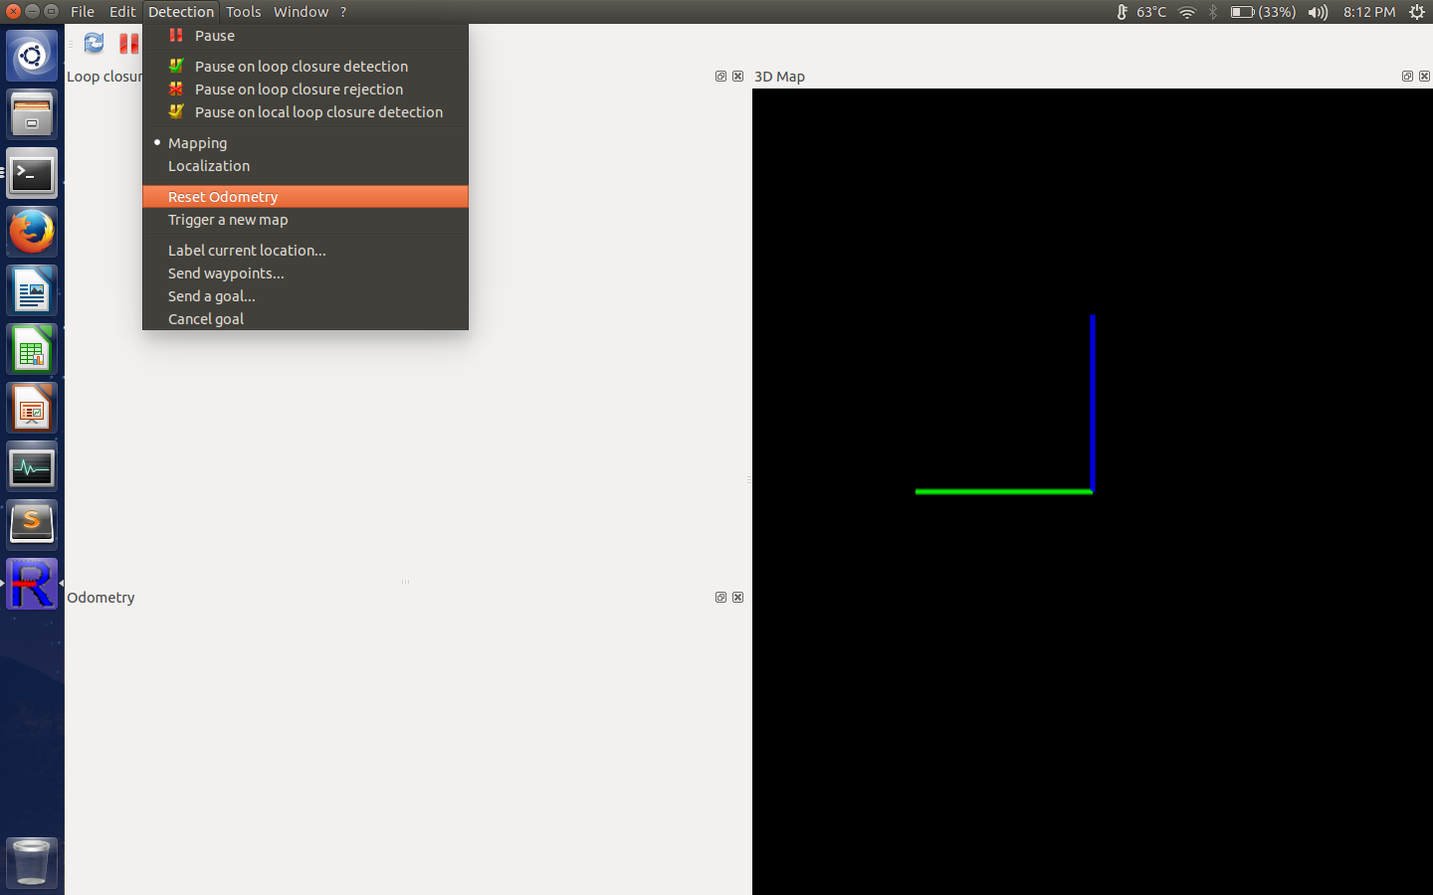
Procedure
Red - RTAB-Map has lost track of the camera’s location. To start the mapping process again point the camera to a previously mapped location and click on the ‘Reset Odometry’ option in the Detection menu.
Video link - https://youtu.be/eghTYsVoqck

Slide 7
References
http://introlab.github.io/rtabmap/
https://en.wikipedia.org/wiki/Simultaneous_localization_and_mapping

Slide 8
THANK YOU!

